Slide 1
Information Systems
Introduction

Slide 2
We’ve got Problems…
people/groups want to get things done, i.e. solve problems in their world.
  travel from one place to another as quickly as possible
  invest savings for the future
  plow the streets of a city
  schedule a team’s football games
  select a group of employees meeting some set of criteria
  decide who receives loans from our banks.
  etc…
Notes:
A pandemic spreads – how do we address? Who gets vaccines, how do we distribute, how far apart must people be…
Supply chains are disrupted – when/how much do we order
Inflation is high – what do we buy / not buy / invest / save…
Stock prices are down – sell? Hold?

Slide 3



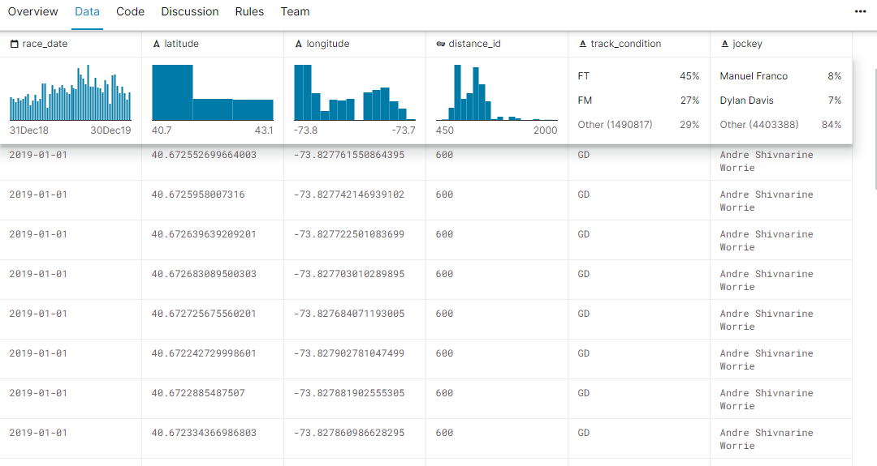
and there is Data
Things happen in the world (and beyond), naturally,
  we can observe them, record data concerning them (e.g. temperature)
And people make choices, take action, etc.
  we can record that data too (drive from A to B, live in city X, earn $Y, , go to website W, purchase item I online, etc.).
So data is because things happen and we can record that.
Kaggle horse racing

Slide 4
And there is Big Data!
We can record and store a large volume of a wide variety of things, very quickly (high velocity)
→ “the 3 Vs of big data”
lots of human-generated data now (a big reason: mobile computing), turning out to be very useful
algorithms and technology have been developed to use big data productively, where traditional databases would fail

Slide 5
Big Data – How Big?
We are generating 402.74 quintillion bytes of data every day (compared to 2.5 in 2012)
Over the last 2 years, 90% of the world’s data was generated
Each minute, modern Internet activity includes:
  over 347,000 DeepSeek AI queries,
  138.9 million Instagram Reels viewed,
  229 million minutes of Microsoft Teams meetings,
  over 4.5 million YouTube videos watched
  1.4 million Tinder swipes
  1.04 million Slack messages
  360,000 X posts
  up to 100 new Spotify songs, and
  4,080 compromised data records.
Source: https://rivery.io/blog/big-data-statistics-how-much-data-is-there-in-the-world/
Source: https://www.domo.com/learn/infographic/data-never-sleeps-5

Slide 6
Data & Problems
So we have:
  data – useless in and of itself, and
  problems to be solved
What do we do?
  Record/organize/store the data
    The data is transformed to become information and maybe even insight
  Analyze the data
  Make decisions based on our analysis of the data
** So we can use the data to help solve our problems. **

Slide 7
How does data/information figure in to Operations Research / Analytics?
1st let’s get our definitions straight:
Operations Research (O.R.)
  application of quantitative methods to aid in decision making
  can help optimize under constraints, navigate competing objectives
Analytics
  scientific process of transforming data into insight for making better decisions
The terms are sometimes used synonymously and do have much overlap.

Slide 8
Types of Analytics
Descriptive Analytics - preparing, organizing and analyzing historical data, identifying any trends, to answer the question, “what has been happening?“
Predictive Analytics - using mathematical methods, historical data, and any assumptions about future circumstances to uncover relationships in data and answer the question, “what could happen?“
Prescriptive Analytics - answers “what should be done to optimize objectives given any constraints?", factoring in descriptive and predictive analytics (what's happened/will happen) and by using mathematical and fact-based optimization techniques

Slide 9
Example Problems in O.R./Analytics using Data

Slide 11
Train Disruption Data (sample)
…
looking for patterns

Slide 12
Visualizing Train Disruption Data
looking for patterns…

Slide 13
Visualizing Train Disruption Data
looking for patterns…

Slide 14
Visualizing All Train Data
looking for patterns in a “Marey chart”…
Each diagonal line represents a single train

Slide 15
Visualizing Train Disruption Data
Dots at (location, time) of disruptions

Slide 16
Visualizing Train Disruption Data
Same as previous plot but now includes train direction

Slide 17
Close-up on previous plot and connecting the dots…

Slide 18
Patterns?
Disruptions caused by a rogue train (due to hardware problems) travelling in the opposite direction of the affected trains.

Slide 19
(To learn more, see https://medium.com/datagovsg-blog/how-we-caught-the-circle-line-rogue-train-with-data-79405c86ab6a. You may need to search “circle line” if you are redirected away from the article.)

Slide 20
(Source: Predictive Analytics by Eric Siegel)

Slide 21
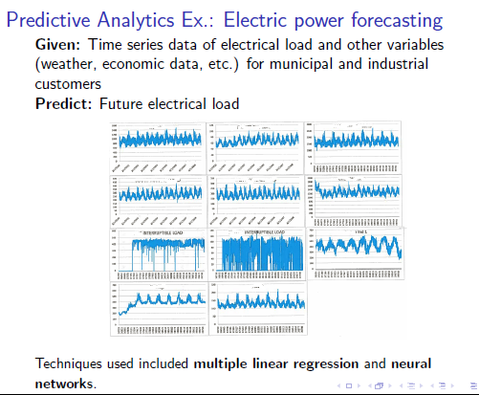

Slide 22
Prescriptive Analytics Example: Electric power portfolio optimization
An electric power utility must generate and/or obtain power to meet its customers' demand.
The utility has a set of options from which to fill its power “portfolio".
Utilities generally optimize their portfolios in the sense of minimizing cost subject to numerous constraints.

Slide 24
Formulated as Mixed Integer Program (see Lin Opt)
Decision Variables: x_{a} =megawatts (MW) to purchase of asset a, etc.
Fairly complicated objective function and numerous constraints...
Decision support system implemented in Excel using VBA (this course)
Notes:
Information system, vba, dss, visual analytics

Slide 25
Notes:
visual analytics

Slide 26
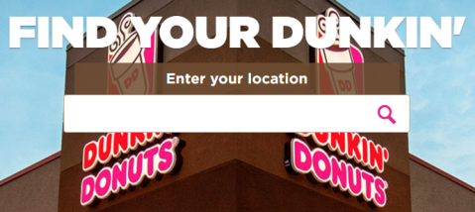
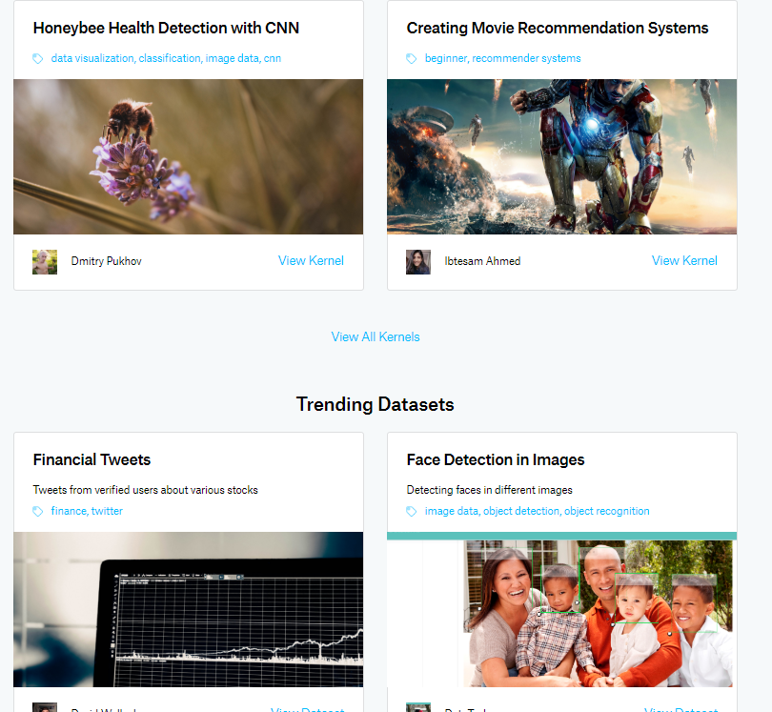
More examples
Isaac Slavitt Dunkin’ Donuts Web Scraping
Kaggle Datasets and Machine Learning
CGA Capstone: Optimizing Placement of
CG Recruiting Offices

Slide 27
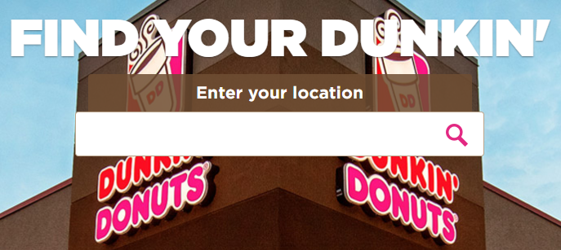
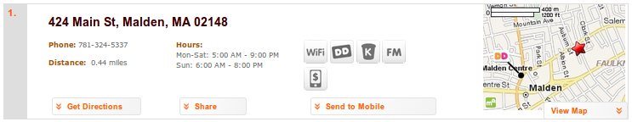
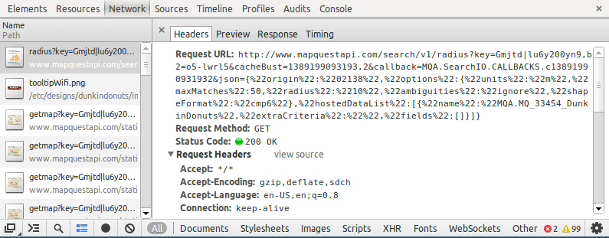
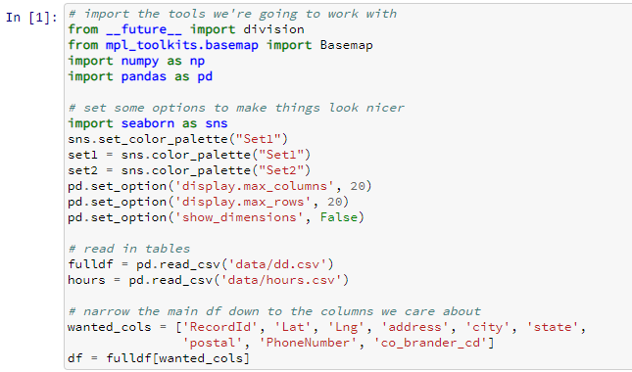
Scrape the html page with Python
Notes:
Webscraping in python

Slide 28
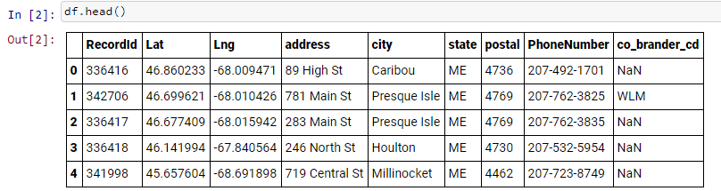
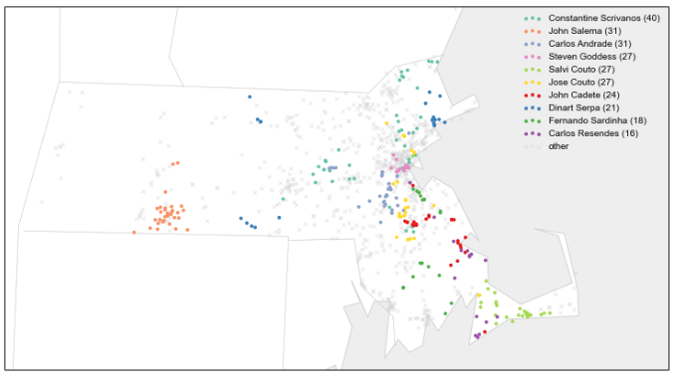
Isaac @ Dunkin (cont.)
Some results in a Python pandas data frame and visualized geographically with Python
Loads more to it, see: http://isaacslavitt.com/2014/01/08/dunkin-donuts-data-analysis/

Slide 29
Recent Capstone: Optimizing Placement And Staffing of U.S. Coast Guard Recruiting Offices
Problem Statement Maximize number of possible recruits based on Recruiting Office location and how many recruiters assigned to each office.
Methodology:
•Linear Program
•Binary Decision Variables
•Solved with Python through PuLP
Dayneko, Franco, Rhodes, & Stein, 2017

Slide 30
Kaggle.com - “the place to do data science projects”

Slide 31
Back to this course:
Information Systems
Information system – “an integrated set of components for collecting, storing, and processing data and for providing information, knowledge, and digital products”
This semester will be broken into three modules:
Data collection, cleaning + processing
Data storage + databases
Decision support tools + data visualizations
(our approach to “providing information, knowledge, and digital products”)
Source: https://www.britannica.com/topic/information-system

Slide 32
Some Course Tools & Approaches
Data collection, cleaning + processing
  Pandas library in Python
  Web scraping using Python and HTML
Data storage + databases
  Access
  SQL
  connections to Excel, VBA, Python
Decision support tools + data visualizations
  Excel
  VBA
  Python
and more…

Slide 33
Related areas
Data-driven decision making (DDD) – the practice of basing decisions on the analysis of data, rather than purely on intuition
Data science – a set of fundamental principles that guide the extraction of knowledge from data with the ultimate goal of improving decision making
“If we have data, let’s look at data, if all we have are opinions, let’s go with mine!” -- Jim Barksdale, former CEO of Netscape
Source: Data Science for Business by Provost & Fawcett

Slide 34
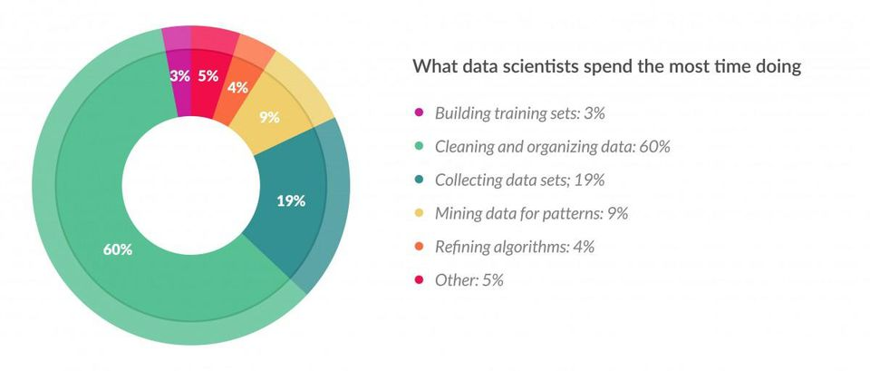
What do data scientists spend their time doing?
Refining algorithms
Mining data for patterns
Cleaning and organizing data
Building training sets
Collecting data sets
Other
Match task to % of time
Source: https://www.forbes.com/sites/gilpress/2016/03/23/data-preparation-most-time-consuming-least-enjoyable-data-science-task-survey-says/#755cd9316f63

Slide 35
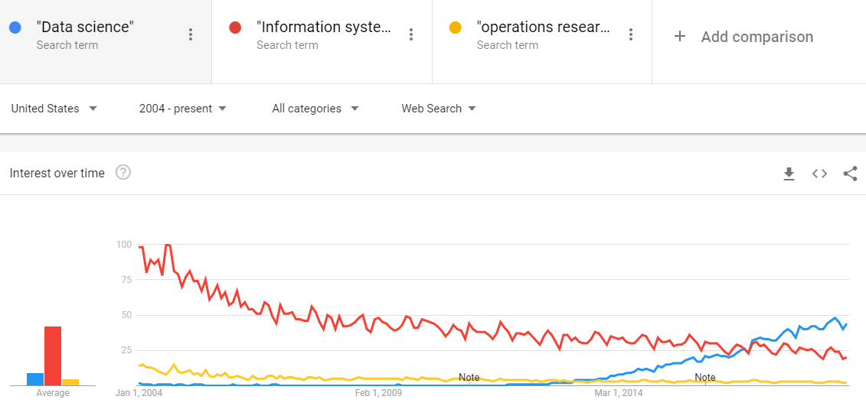
Google trends (for what it’s worth)

